Slide 1
Neufeld Lab Mtg
Greg Gloor
ggloor@uwo.ca
@gbgloor

Slide 2
Motivation
Compositional nature of data recognized from start
but unknown how to deal with compositional problems
Ecology/Microbiology
proportion/relative abundance
rarefaction
SAGE/Transcriptome
count normalizations
RPKM (Mortazavi: 2008)
TPM
scaling normalizations
TMM (edgeR Robinson: 2010)
RLE (DESeq, DESeq2 Anders: 2010)
SRS (Beule, 2020)
ratio data
qPCR (Vandesompele 2002)
compositional approaches

Slide 3
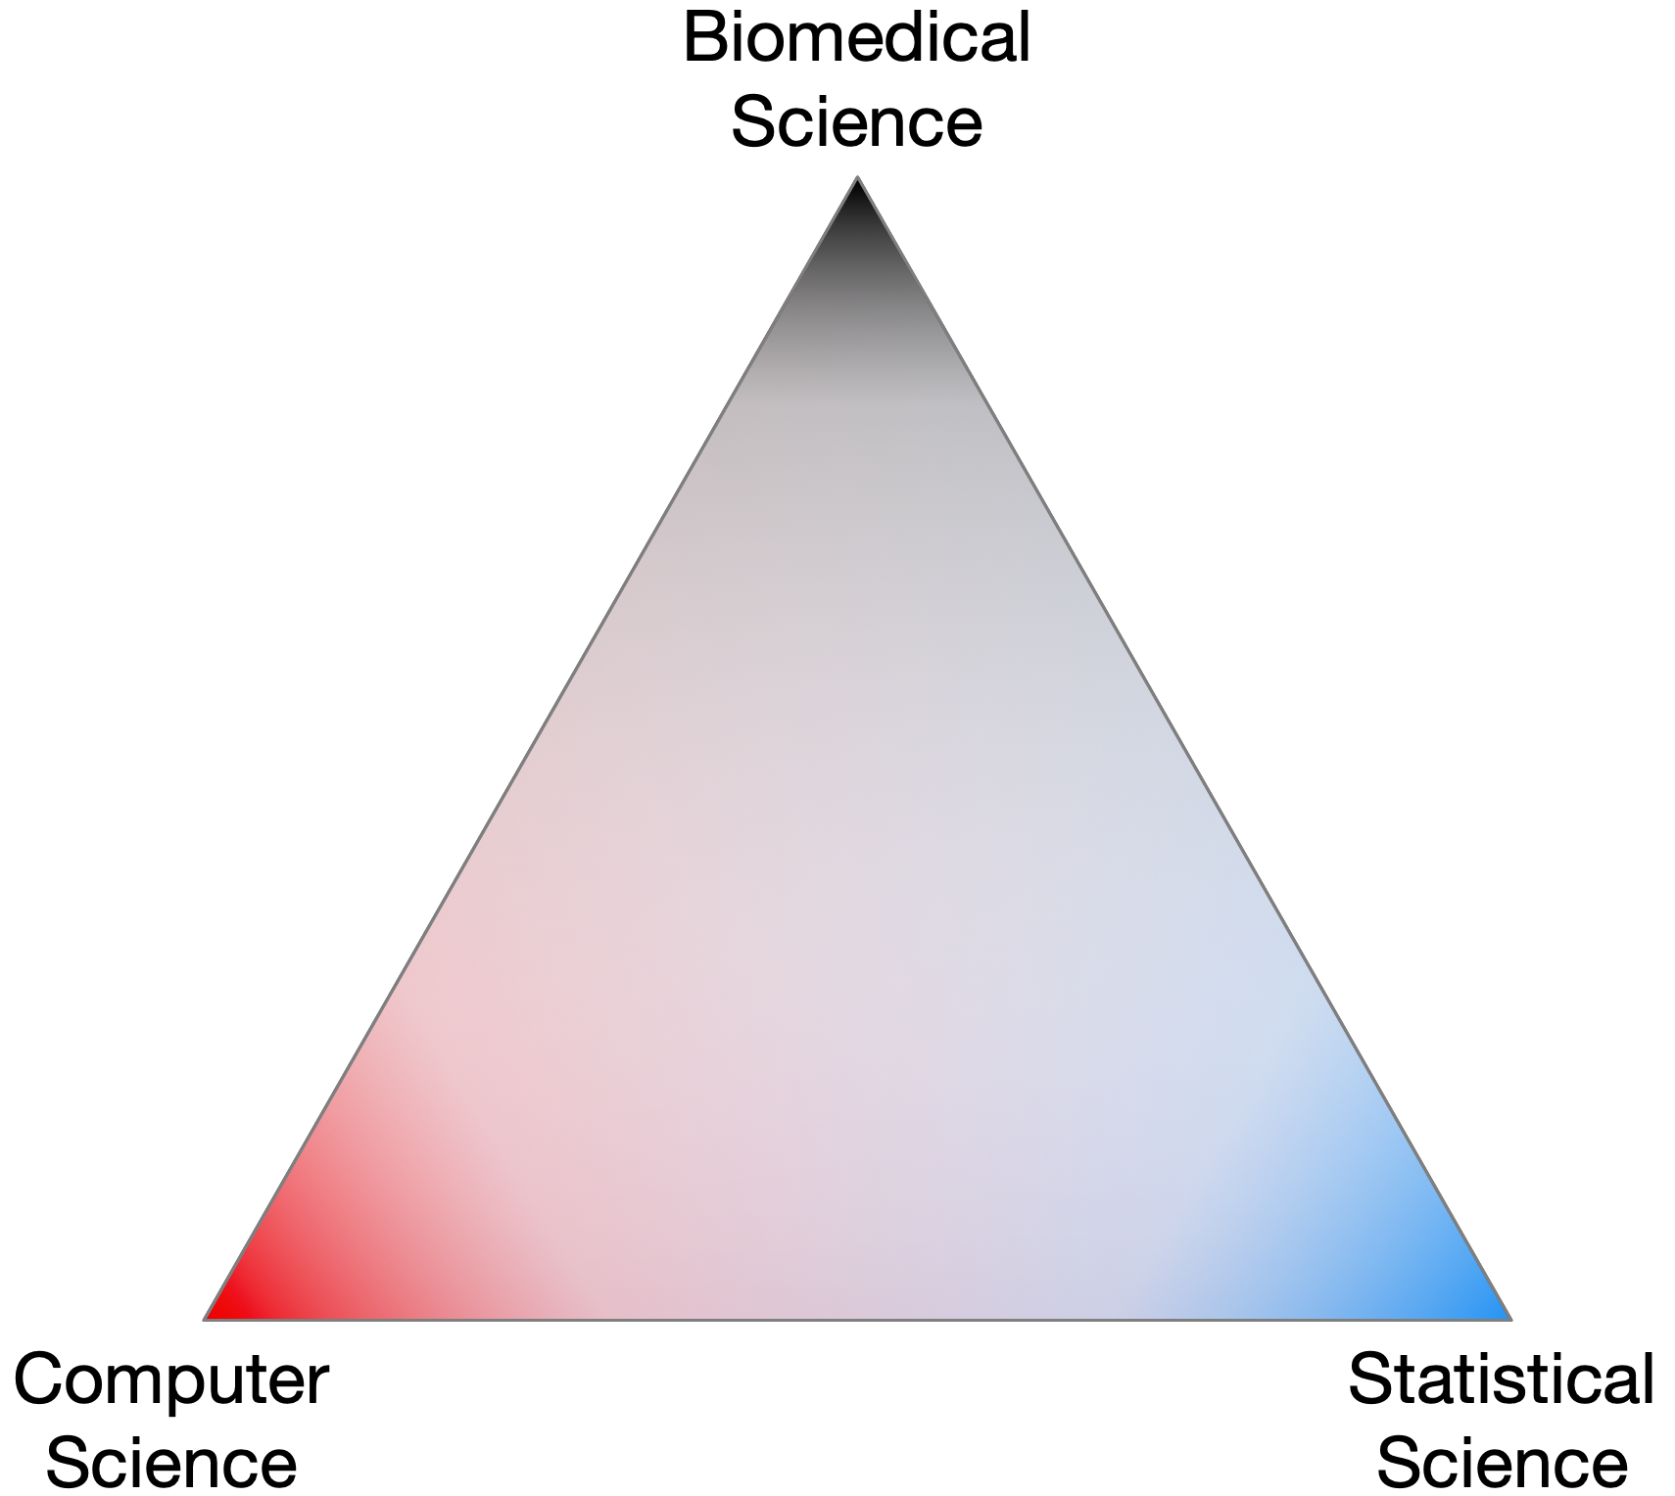
The triangle of trust
Notes:
Complex data and everyone trusts everone else without necessarily having the domain-specific expertise needed

Slide 4
Nobody sees the whole elephant

Slide 5
Wet lab researcher degrees of freedom
RDF are nearly infinite in the design
Notes:
Every choice along the way changes the results. Early data from pyrosequencing and V1-3, almost all later data collected on Illumina and V4

Slide 6
Bioinformatic researcher degrees of freedom
Notes:
It is common to apply open or close OTU picking, to try rarefying or RLE transform, then to use Bray-Curtis, JSD, W and UW unifrac on the same dataset. Results are cherry picked. This is a major source of FP. The probabalistic Bayesian + log-ratio approach is internally consistent and robust

Slide 7
We have a problem
RDF is a major red flag when evaluating paper
Is it any wonder that different groups can get different answers about the same system?
Is it any wonder that so many datasets are irreproducible?
So much variation, no standard of truth
Perceived need to be first not the need to be correct

Slide 8
Where does data come from?
We start with random DNA or RNA fragments from environment
We take a random sample and make a library
A random sample of the library is sequenced and mapped to genomes
This generates a table of counts per feature in each sample
Very sparse data
Asymmetric
may have 0 values in one group but not the other – these have information
Notes:
Many more fragments than we can count

Slide 9
Sequencing makes sausage
Gloor et al Front. Micro. 2017

Slide 10
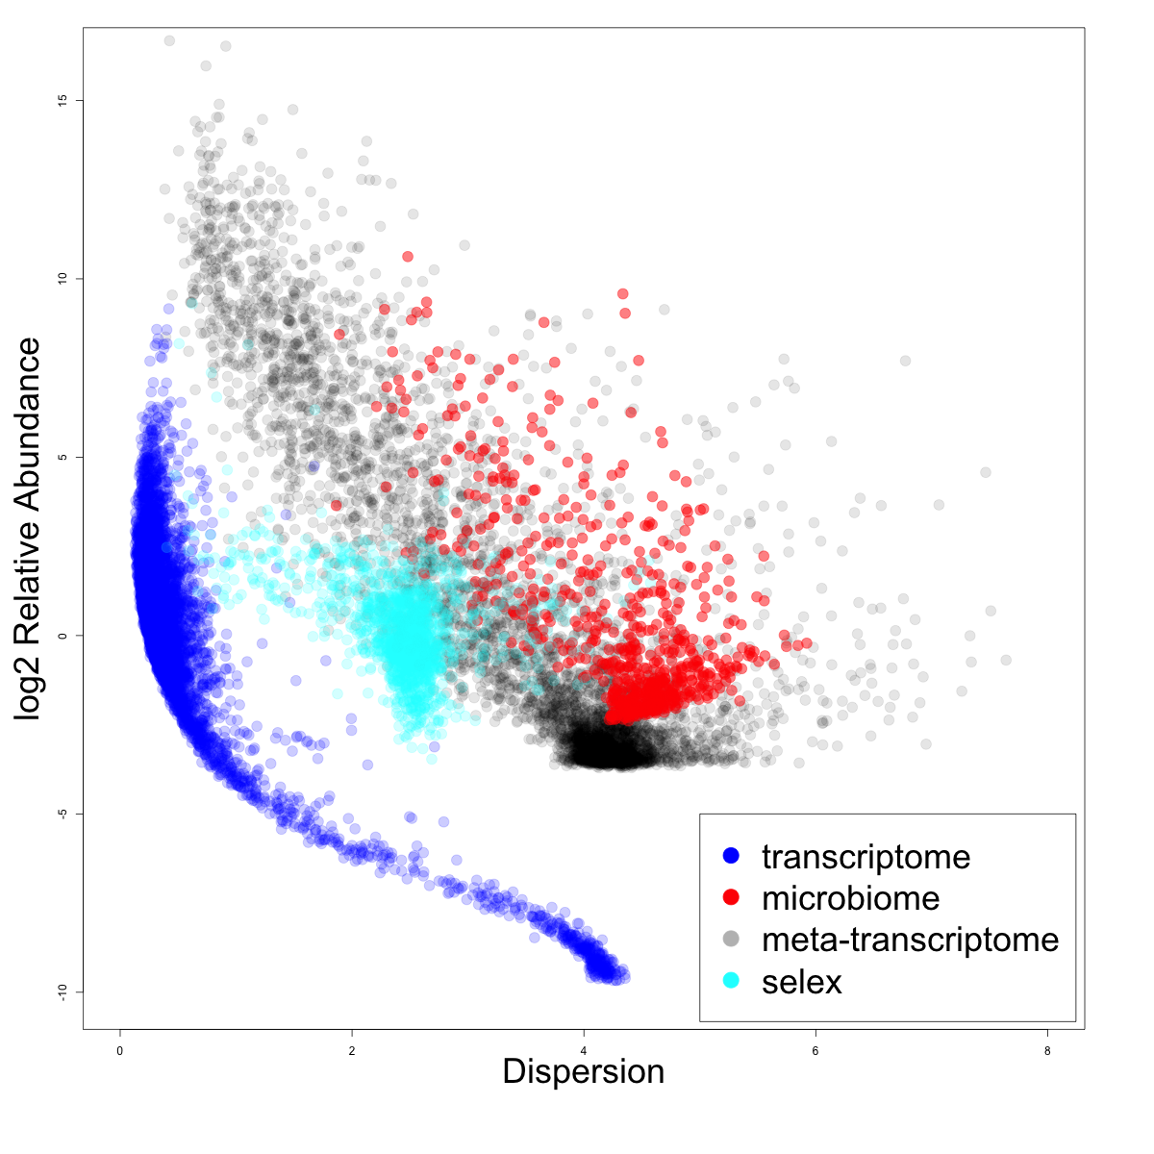
Dispersion v. rAbundance
high variance datasets
microbiome
low variance datasets
RNA-seq

Slide 11
Data as counts
Example 100 random sample sets
range=1800-2200
range= 8000-12000
range=450-550
🐯
🐞
👽
Gloor et al Front. Micro. 2017

Slide 12
As delivered by sequencing
Constant sum of 1000
Constant sum operations:
Count normalization
Rarefaction
Proportion
percentage, relative abundance
Sequencing
Simplex: one fewer dimensions than variables
Problems remain regardless of dimension
Gloor et al Front. Micro. 2017

Slide 13
Normalization is no help at all
Once data are on the simplex, they cannot be removed easily

Slide 14
Log-ratios for CoDa
Count
Sequencing
Simplex
27
853
66
740
112
216
clr(x) = [ log(x₁/g_{X}), log(x₂/g_{X}), … log(x_{D}/g_{X}) ]
X = [ x₁, x₂, … x_{D} ], g_{X} = geometric mean of X
Aitchison 1986. Stat. Anal. Comp Data
Pawlowsky-Glahn, 2015. Mod. Anal. CoDa
Notes:
Scale dependence - hence ‘normalization’
Correlation and covariation are unreliable
Addition and subtraction are not useful operations
Subsetting and aggregating are problematic
Sparse data is an issue

Slide 15
Real sequence data are variable
Same features from same samples from the same library
Sequenced on different lanes
We should get comparable answers
We can estimate the variability by sampling Dirichlet instances
Multivariate, constrained balls in an urn
Fernandes, PLoS ONE 2013
Gloor, Aus J. Stat. 2016

Slide 16
Think of the 0s!
0 count can be real – or a non-detect
0 count is not 0 probability to detect the count
p_{i} = 0 is strong, invalid, assumption
[P_{i} > 0, P_{i} →0]
Fernandes, PLoS ONE 2013
Gloor, Aus J. Stat. 2016
EBI Hinxton

Slide 17
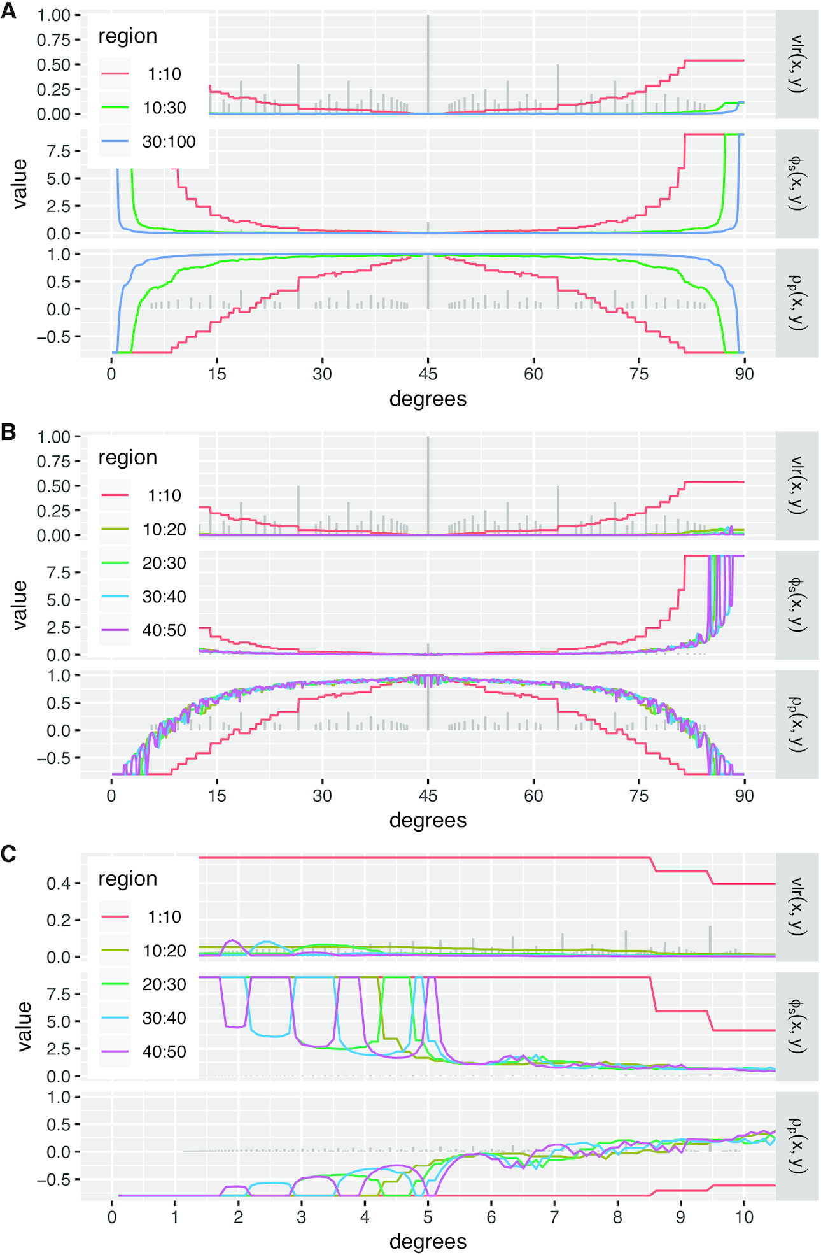
And it is worse - count data are multidimensional lattices
Modelled perfect correlation
Effect of lattice on detection
Lovell NARGB 2020

Slide 18
Summary
Uncertainty is not a bad thing as long as you know
A - your data are uncertain
B – the results are therefore uncertain
C – you account for the uncertainty in your interpretation
D – you remember that uncertainty is the default state
Don’t trust anyone’s results, especially your own because of the RDF
Examine your inbuilt biases on a regular basis
Learn all you can about the methods, wet and dry
Don’t blindly trust something because it is published or ‘that’s the way we do it’

